Slide 1
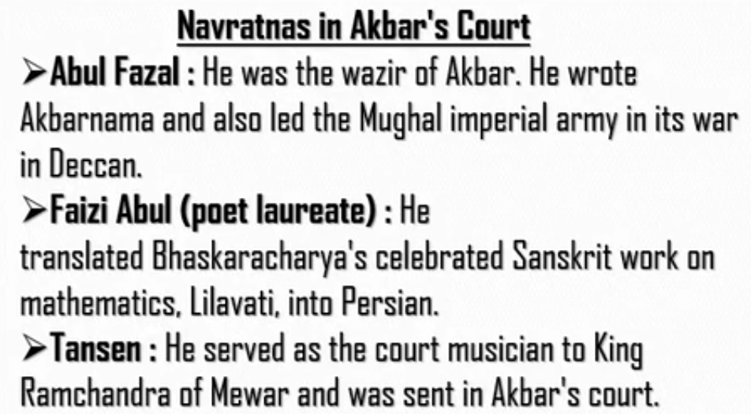
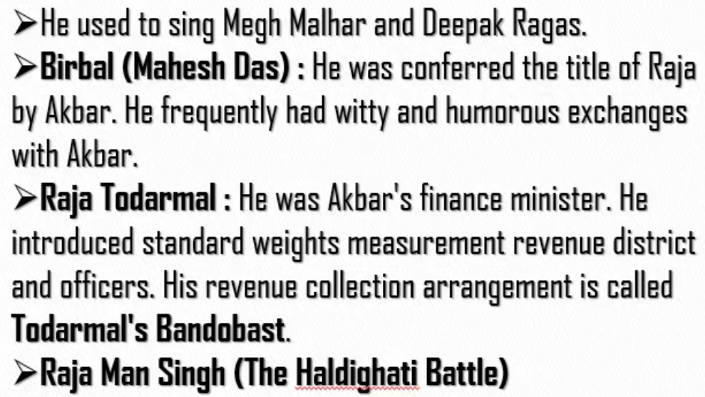
Raja Man Singh helped Akbar in the battle of Haldighati

Slide 2
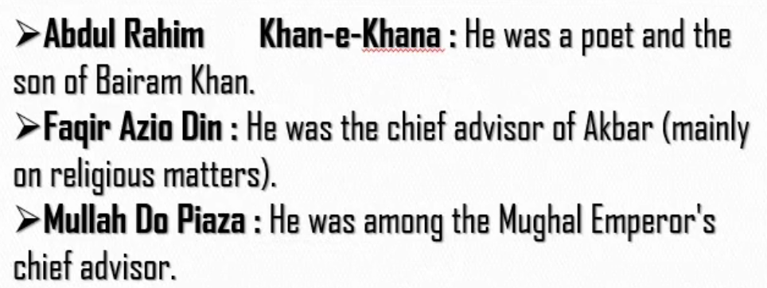
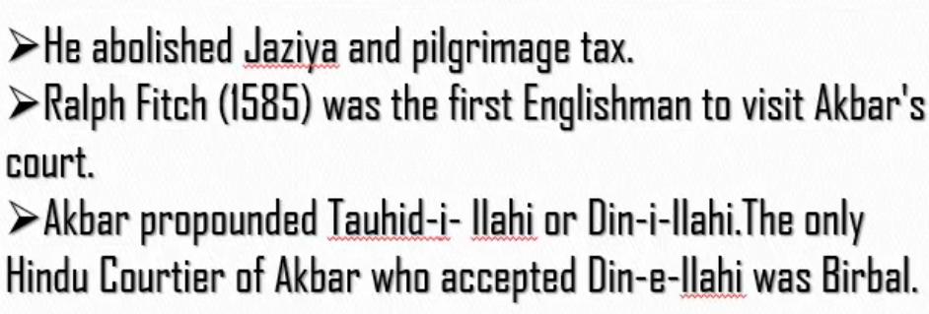
See who was Bairam Khan from previous ppt (11. Mughals -1)

Slide 3
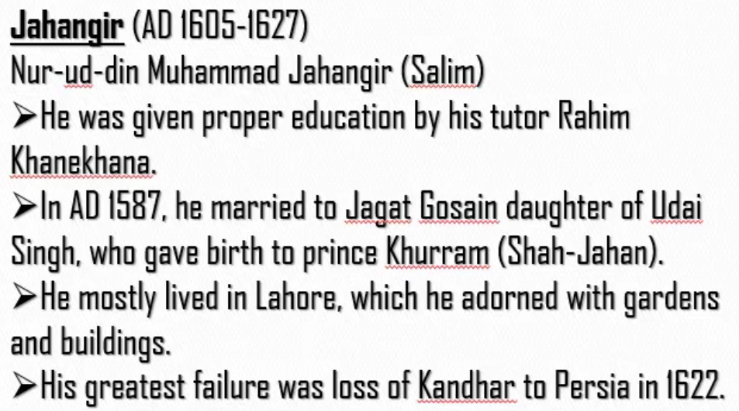
See previous slide to know who is Rahim Kanekhana.

Slide 4
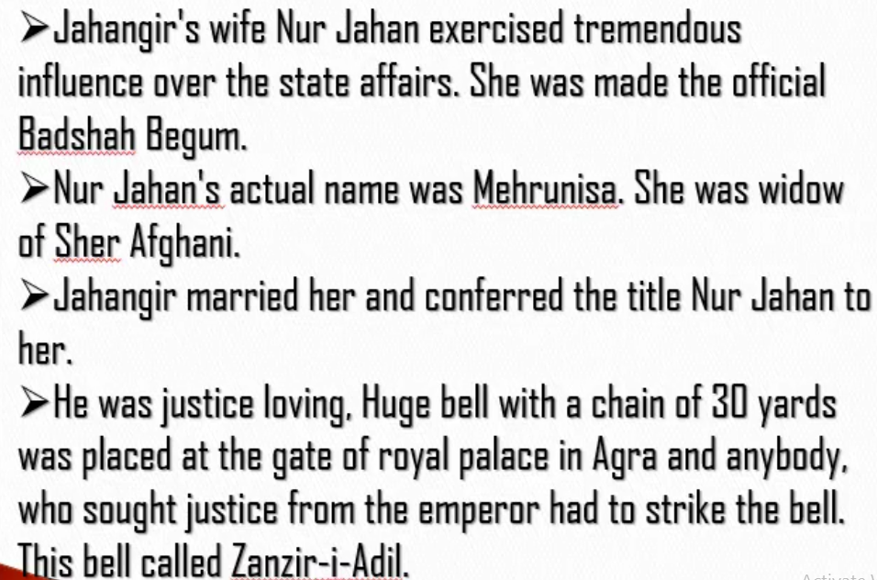
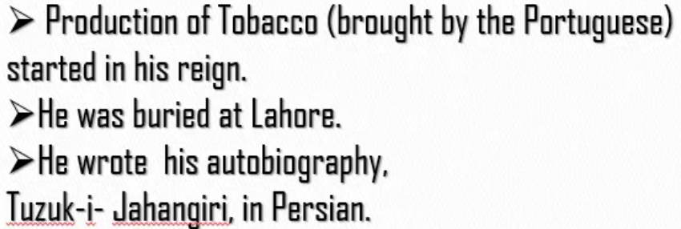
Mehrunisa was the wife of Sher Afghani.
When Sher Afghnai died , Mehrunisa became widow.
Jahangir married Mehrunisa who was widow and gave her the title Nur Jahan.

Slide 5
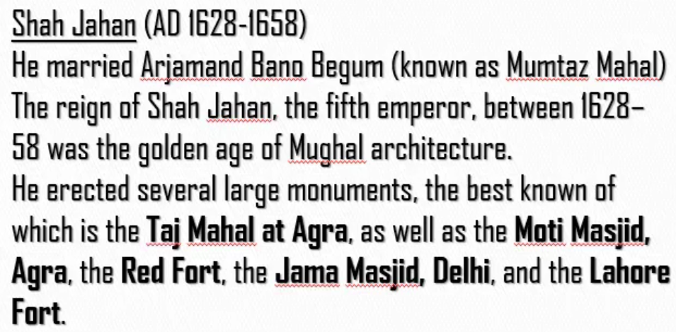

Slide 6
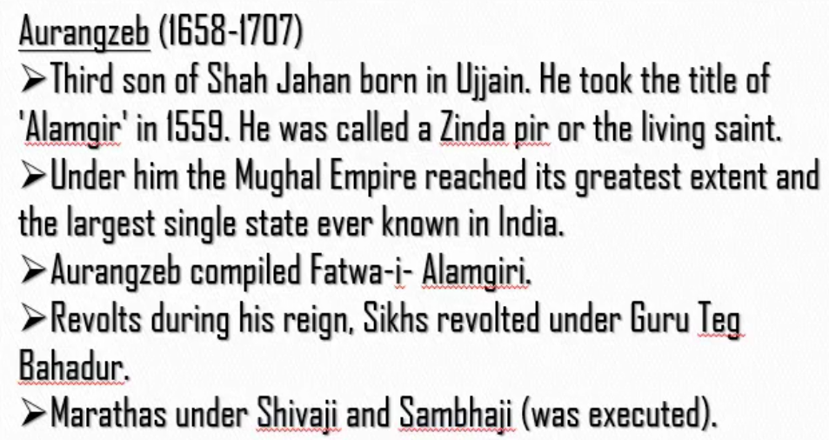
Shah Jahan had four sons. When Shah Jahan fell ill, all his three sons started fighting for the throne.
Finally, the third son of Shah Jahan, Aurangzeb won the fight and ascended the throne.
Revolts during the reign of Aurangzeb:
Sikhs revolted against Aurangzeb under 9th Sikh guru called Guru Teg Bahadur.
Marathas revolted against Aurangzeb under Shivaji and Sambhaji
Guru Teg Bahadur, Shivaji and Sambhaji were all executed by Aurangzeb.
Sikhs and Marathas revolted against Aurangzeb because Aurangzeb wanted everyone to follow Islam and leave their religion

Slide 7
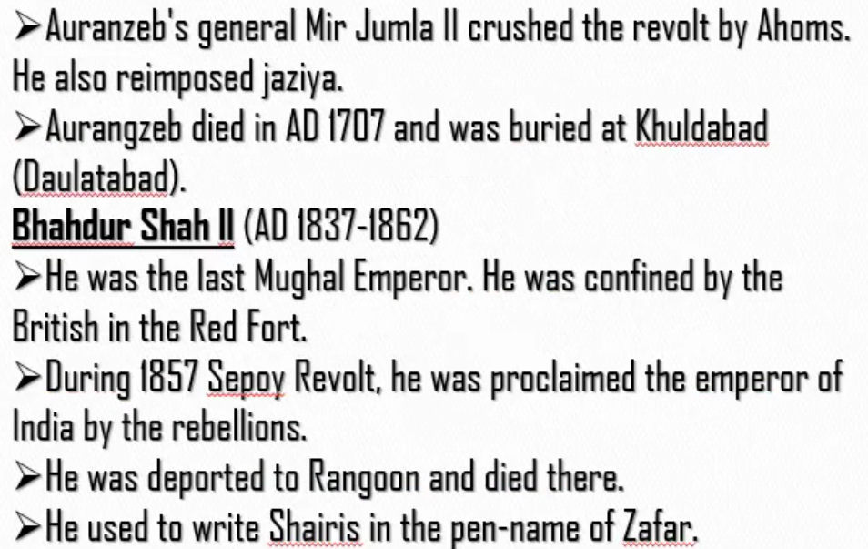
Jaziya – High tax paying system. It was abolished by Akbar. Aurangzeb re-introduced it.
British deported (“gadi par”) Bhahdur Shah II to Rangoon.
Confined - Caught

Slide 8
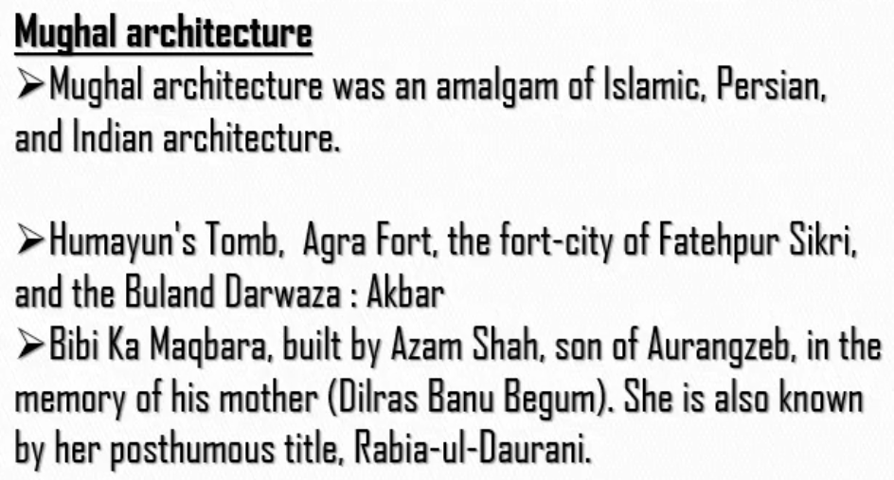
Posthumous – “Maranotthara”

Slide 9
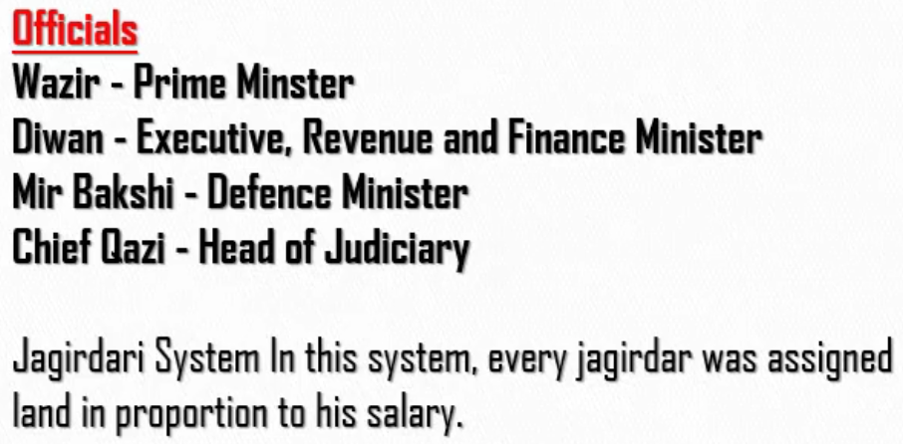
Jagirdar – People who collected taxes.
Jagirdars did not get money as their salary.
Jagirdars got land in place of money
Jagir – Land

Slide 10
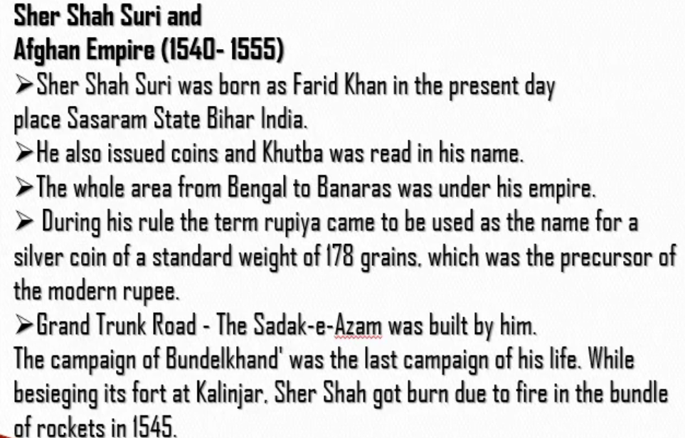
Khutba – Praising words (Birudavali)
Campaign here refers to war.
The fort of Bundelkhand was in Kalinjar. While attacking the fort of Kalinjar he was burnt by the fire from the bundle of rockets.

